Slide 1
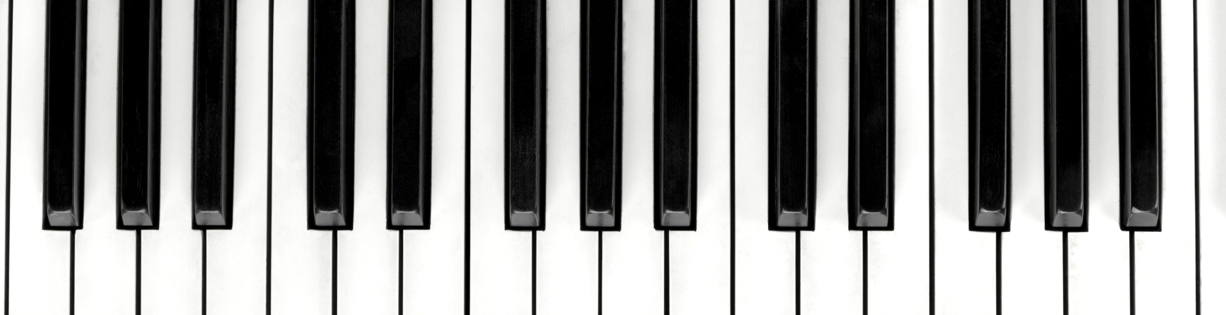
Final Project
CIT 180 – Fall 2023

Slide 2

The purpose of my site?
When I’m not working my way through homework assignments, I spend some of my free time with my friends Bob, Jamie, Mark, and Rob. The five of us have a classic rock band that plays around town during warmer months. We have been playing in public for over five years, but not too many people know about us. We need a website! This site is a rough draft, demonstrating a few ideas I have had for a new site for the band.

Slide 3
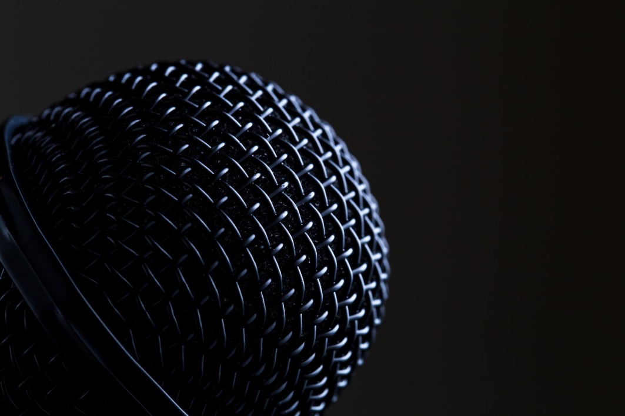
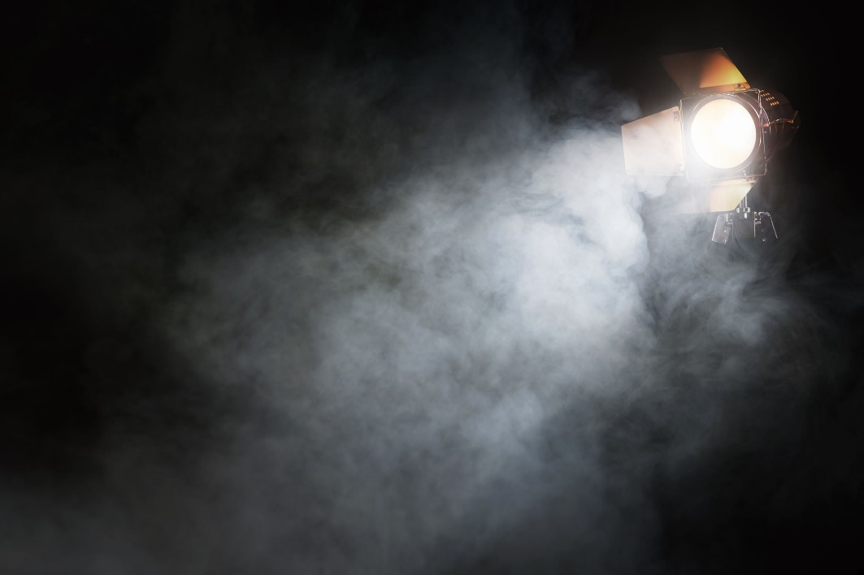
My intended audience…
Partially, it’s for our existing fans, to stay in touch with us and find out where we’re playing next.
But it’s also for people who haven’t heard of us yet. The Photo Album and Blog would provide a way to learn more about us.

Slide 4
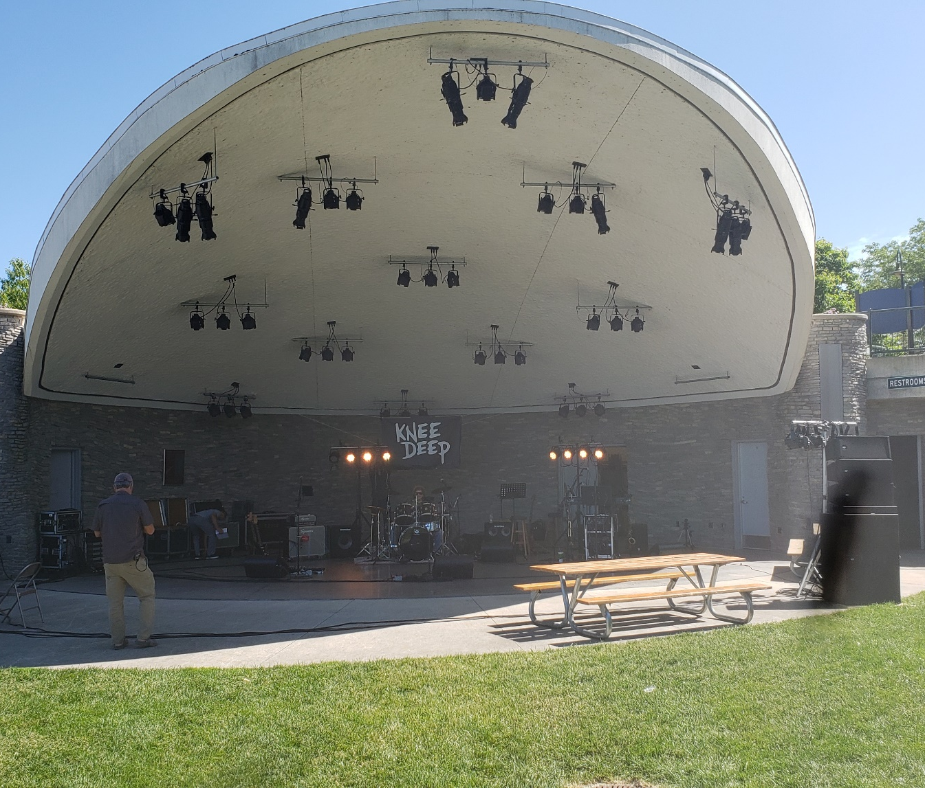
My chosen color scheme?
This was hard to decide, and it’s still subject to change. A black background seems appropriate for a site that will have many photos of late-night gigs on dark stages. Beyond that, I simply thought that reds, yellows, and oranges might go well with that, or at least would be a good start. But then again, not every gig we play is in the dark!

Slide 5
Layout and design…
CSS Grid – really easy to rearrange things & see how they look
Vertical nav – more visually appealing with the sliding transition from the left, on any device with any size viewport
An ‘aside’ with photos – the right photos here can grab and keep your attention

Slide 6
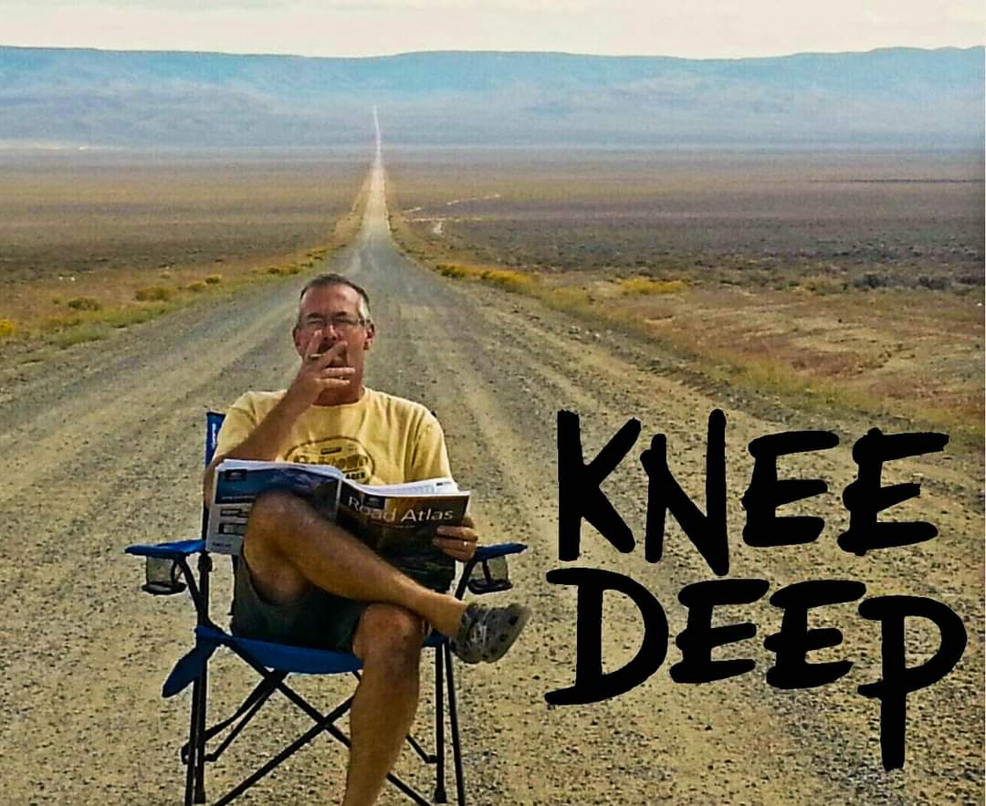
My challenges
The photos in my ‘aside’ kept appearing larger than the 1/6th of the viewport they were given to appear in. This was because I had removed all the text from the center ‘section’. Filling that section with text again forced the photos back to the right size.
And switching from ‘vw’ to ‘em’ font sizes controlled the size of the menu buttons much better when resizing the browser window.

Slide 7
What I did well?
I’m happy with the slide effects and transitions, especially the fade effect on the ‘Knee Deep’ logo background. The background of the center text block goes from 100% transparent to about 15% transparent, making it look like the background image itself is transitioning from full brightness to a nice muted background.

Slide 8
What could I do better?
Plenty! I spent too much time playing with different transitions, I needed to spend more time picking out a good color scheme.
And I think it would look better if the banner, menu, and aside all had borders, maybe?
I think I would also re-think my font choice to something less cartoon-ish. And change the font sizes, they’re too big.

Slide 9
Merry Christmas, and have a SAFE and fun New Year!
Then let’s all get together again for some Javascript in 2024!

